Slide 1


Slide 2
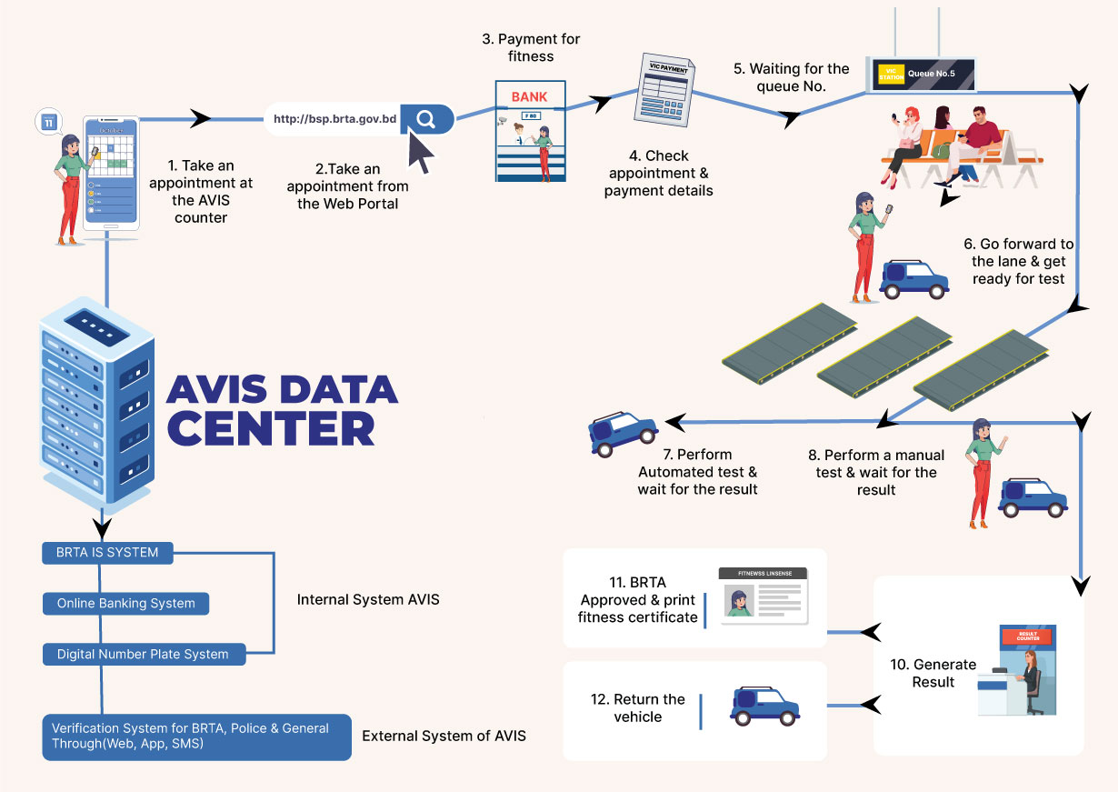

Slide 3
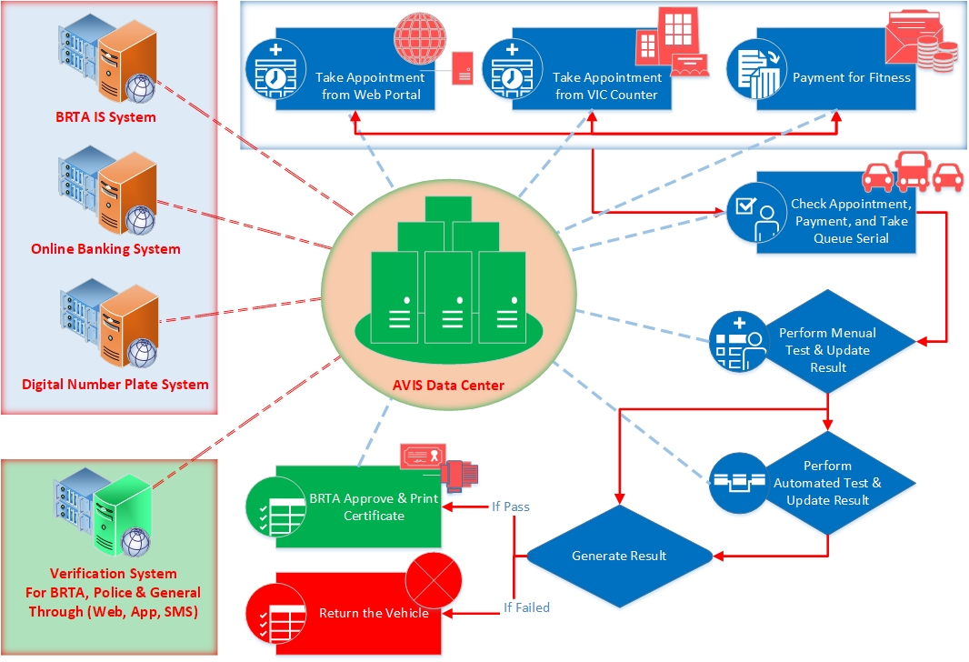

Slide 4
System Demonstration

Slide 5
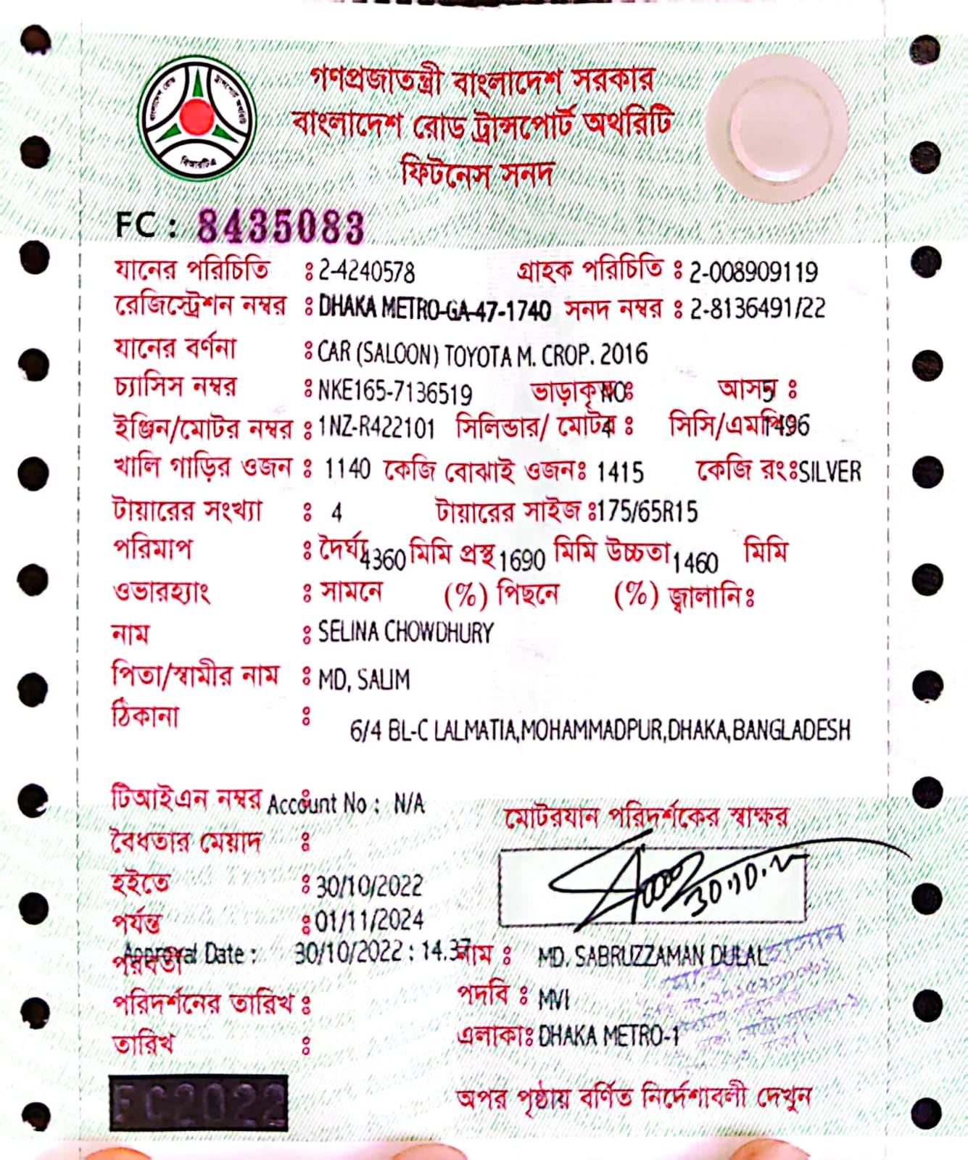
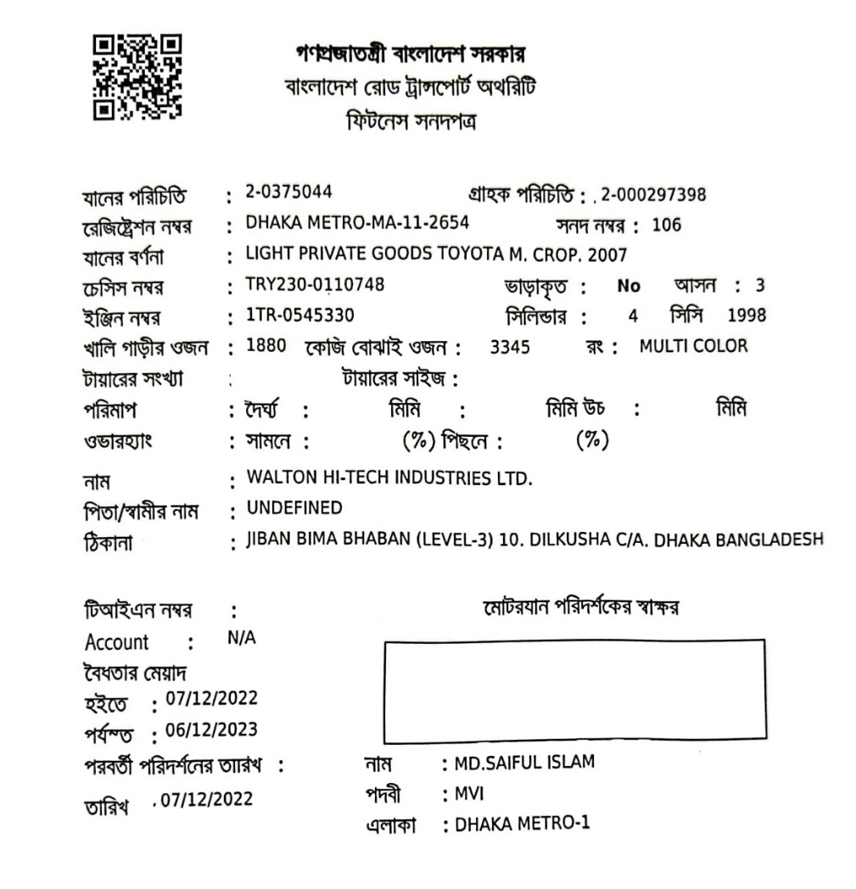
Certificate Format
Current
Proposed

Slide 6


Slide 7
Thank You

